Slide 1


VQRP+ Crime Definitions and Supports
Narrated by:
Lakehead University Social Work Students: Chelsea D. and Noelle J.
**Please note that this document is to be used as a guide and is accurate as of April 2023. Changes in Legislation and/or Legal/Law Interpretations and/or alterations by the Ministry of Child, Community and Social Services may supersede such information.
All calls receive short term phone support, advocacy, referrals and trauma informed responses.

Slide 2
Thunder Bay and Area Victim Services
(referred to as TBAVS throughout)
Crisis/Referral Line 807-684-1051 referral@tbayvictimservices.ca
Contents
Title Page | 1
Contents | 2
Important Information | 3
Homicide | 4
Human Trafficking | 5
Intimate Partner Violence | 6
Sexual Assault | 7
Serious Assault/Serious Injury | 8
Hate Crime/Criminal Harassment | 9
Tragic Circumstances | 10
Historical Child Sexual Abuse | 11
Elder Abuse | 12
Note: Common Confusion
Please call VWAP (Victim/Witness Assistance Program), Thunder Bay 807-626-7120
If you are looking for supports/information/assistance in the areas of the criminal court process, such as
the criminal justice process and your specific case (e.g., court dates)
facilitates victim's input and liaises with Crown Attorneys, police, regarding bail, safety, resolution of charges, release conditions, publication bans, testimonial aids, trial preparation and court orientation
information and support on Victim Impact Statements, Statement on Restitution
facilitates access to court orders, such as bail conditions, probation orders, peace bonds
debriefing and follow-up support
Please see Tragic Circumstances: for Sudden Death/Suicide, Arson, Collisions as a result of a crime, and held Crime Scene support.

Slide 3
3-Important Information
**Not all crimes are eligible for VQRP+ funding. It is important to reach out to 807-684-1051 to review your situation.
TBAVS Offers: Immediate emotional support, practical assistance, referrals and advocacy to individuals who have been affected by the result of a crime or tragic circumstance, without judgement in order to lessen the impact. All calls receive trauma responses.
Victim: An individual who, during a criminal act or traumatic event, suffers loss, injury, harm or trauma. Victims may be family members, dependents and/or witnesses.
Take note that some crimes may have time sensitivity reporting requirements. All crimes served by VQRP+ must have occurred in Ontario. TBAVS is an alternative to Police reporting for Human Trafficking and Intimate Partner Violence.
Established in 2003, in Thunder Bay and Area, we are governed by a Volunteer Board of Directors and in Agreements with Emergency Services. Service Delivery is through the Executive Director, Crisis Response Workers, and our amazing Crisis Response Volunteers who are professionally trained.
Response Process: May make a referral via phone 807-684-1051 or email referral@tbayvictimservices.ca by: direct victim, witness, family, guardian, social service provider, and all emergency services. Calls will be responded to immediately or within 20 minutes if responder is on the line with another caller. On Scene response may occur when available and safe.
The VQRP+ Program: May offer financial funding for VQRP+ approved processes to victims of crime who require immediate assistance if not available via other sources, as VQRP+ is last resort. VQRP+ requires Consent/Application forms for approval and the crime occurred within the timelines. All supports must be as a direct result of the crime itself.
VQRP+ Process: Once an Application and Consent form are completed and received, an application is submitted to VQRP+ Ontario. VQRP+ approval can take up to 3-5 business days. However, dependent upon request, can be a very quick turnaround. TBAVS does not make the final approval. VQRP+ Ontario makes the payments to VQRP+ approved services, not TBAVS.
If housing property has been damaged, personal insurance and/or landlord would be explored first.
If you identify as Indigenous, please inform us as there are Indigenous related resources/supports.
If you want to know what supports you are eligible for, or you are looking for resources, please call us at
807-684-1051.

Slide 4

4-Homicide
Refer to #3 Important Information
Attempting to commit “Homicide” is trying to cause the death of another individual by any means. This could be combined with “Serious Assault”.
Timeline to report: 45 days from the incident
Required:
Police incident and badge number
VQRP+ Application and Consent form to be reviewed and signed
May be eligible for:
Community referrals and support
Due to complexity, please call to review eligibility for VQRP+ funding support
A person commits “Homicide” either accidentally or purposely, causing the death of a human being.
Timeline to report: 1 year from when it is deemed a homicide
Required:
Must have Police incident number and badge number
VQRP+ Application and Consent form to be reviewed and signed
May be eligible for:
Basic funeral services
Emotional support
Community referrals and supports
Homicide support
Who can apply:
*Spouse *Common law spouse *Biological, adoptive or step parent/child/sibling/grandparent/grandchild *Legal guardian *Caregiver or relative who has been living with the direct victim for at least one year immediately before the crime, and where the direct victim is a child *Where the direct victim is Indigenous, immediate family member-aunt, uncle, cousin, caring for the child under Indigenous care agreement or an individual unrelated by blood who is considered to be kin.

Slide 5

5-Human Trafficking
Refer to #3 Important Information
“Human Trafficking” is defined as recruiting, transporting, transferring, receiving, holding, concealing or harbouring a person, or exercising control, direction or influence over the movements of a person, to exploit them or to assist in facilitating their exploitation.
Force, exploitation and control may be used by traffickers through taking away identity documents and passports, sexual abuse, threats to safety, intimidation, physical violence, and isolation.
Timeline to report: 1 year to report from date of incident, unless under the age of 18 then no timeline
Required:
VQRP+ Application and Consent form to be reviewed and signed
May be eligible for:
VQRP+ approved services (trauma treatment, emergency accommodation, basic necessities, etc.)
Community referrals and supports
Safety planning
Go Bags are available for emergency planning
Due to the complex nature of this crime, please contact 807-684-1051 for safety and to determine supports you may be eligible for. TBAVS is an alternative to reporting to Police if there are safety or personal factors to calling Police.

Slide 6

6-Intimate Partner Violence (IPV)
Refer to #3 Important Information
“Intimate Partner Violence” is the use of physical or sexual force, actual or threatened, by an intimate partner or ex-partner. It can include actual harm, as well as direct or indirect threats to harm the intimate partner, children or other family members. It includes both the original act of violence and any breach of conditions or subsequent acts that may impact the safety of the victim/recipient.
Timeline to report: 45 days from the last incident or up to 45 days from the date the accused is released from custody
Required:
VQRP+ Application and Consent form to be reviewed and signed
May be eligible for:
Emergency accommodation, emotional support, community referrals, and safety planning
Due to the complex nature of the crime and for more information on supports, please call 807-684-1051
Go Bags are available for emergency planning
Referrals to IPV Crisis Shelters will be sought first for emergency accommodations and intake completed by the direct victim if required. TBAVS is an alternative to reporting to Police if there are safety or personal factors to calling Police.

Slide 7

7-Sexual Assault
Refer to #3 Important Information
“Sexual Assault” is any sexual contact not agreed to, including unwanted sexual touching or sex; the use of force, threats or intimidation to make an individual do something sexual that they do not want to do; and/or sexual activity that an individual is unable to agree to because they are, for example, unconscious or intoxicated.
Voyeurism/Distribution of Intimate Images is also considered “Sexual Assault.”
Timeline to report: 45 days from the incident
Required:
VQRP+ Application and Consent form to be reviewed and signed
May be eligible for:
Community referrals and support
VQRP+ approved services

Slide 8

8-Serious Assault
Refer to #3 Important Information
“Serious Assault” includes the following criminal offenses: assault/threaten with a weapon, assault causing bodily harm, aggravated assault, criminal negligence causing bodily harm, kidnapping/abduction, forcible confinement, discharge of a firearm (where the individual is at substantial risk of harm), robbery (where it results in bodily harm), arson (where it causes bodily harm or where the home was occupied at the time of the crime), and failure to provide the necessities of life resulting in harm.
Timeline to report: 45 days from the incident
Required:
Police incident and badge number
VQRP+ Application and Consent form to be reviewed and signed
May be eligible for:
Due to the complex nature of this crime, please contact 807-684-1051 to determine supports you may be eligible for.

Slide 9

9-Hate Crime/Criminal Harassment
Refer to #3 Important Information
“Hate Crime” is a criminal offense committed against a person or property which is motivated by hate, bias, or prejudice based on race, national or ethnic origin, language, colour, religion, sex, age, mental or physical disability, sexual orientation, or similar factors.
Timeline to report: 45 days from the incident
Required:
Police incident and badge number
VQRP+ Application and Consent form to be reviewed and signed
May be eligible for:
Community referrals and support
Safety planning
“Criminal Harassment” is engaging in conduct that causes another person to fear for their safety or the safety of others including: repeatedly following the person or anyone known to them from place to place; repeatedly communicating with, either directly or indirectly, the other person or anyone known to them; watching the house, or place where the other person, or anyone known to them, resides, works, carries on business or happens to be; or engaging in threatening conduct directed at the other person or any member of their family.
Timeline to report: 45 days from the incident
Required:
Police incident and badge number
Timeline of recurring criminal/harassment events documented (text messages, phone calls, stalking, etc.).
VQRP+ Application and Consent form to be reviewed and signed
May be eligible for:
Community referrals and support

Slide 10

10-Tragic Circumstances & Suicide
Refer to #3 Important Information
“Tragic Circumstances” consists of an occurrence that is not caused or has not yet been determined to be caused by a crime. Examples include suicide/sudden death, arson, and motor vehicle collisions.
Timeline to report: 45 days from date of or discovery of “Suicide”. All other “Tragic Circumstances” have no timeline with the exception of crime scene coverage.
Required:
Police incident and badge number
VQRP+ Application and Consent form to be reviewed and signed
May be eligible for:
Community referrals and support
Crime Scene supports
Due to the complexity and variety of Tragic Circumstances please contact 807-684-1051 to determine which services you may be eligible for.
**Suicide/Sudden Death”: If the scene is being held as a crime scene, VQRP+ supports may be available.
**Motor Vehicle Collisions”: Must have been as a result of a crime (utilizing vehicle as a weapon, etc.). Insurance policies would be utilized as VQRP+ is last resort. The insurance deductible may be reimbursed if deemed a crime.
**Arson”: If scene is being held as a crime scene, VQRP+ supports may be available. Insurance policies would be utilized as VQRP+ is last resort. This falls under “Serious Assault” if the victim has been harmed as a result.

Slide 11

11-Historical Child Sexual Abuse
Refer to #3 Important Information
“Historical Child Sexual Abuse” is a sexual offence committed against a person when they were under the age of 18.
Timeline to report: There is no timeline to report.
Required:
Occurred when the victim was under the age of 18 and is now an adult
VQRP+ Application and Consent form to be reviewed and signed
May be eligible for:
Community referrals and support

Slide 12
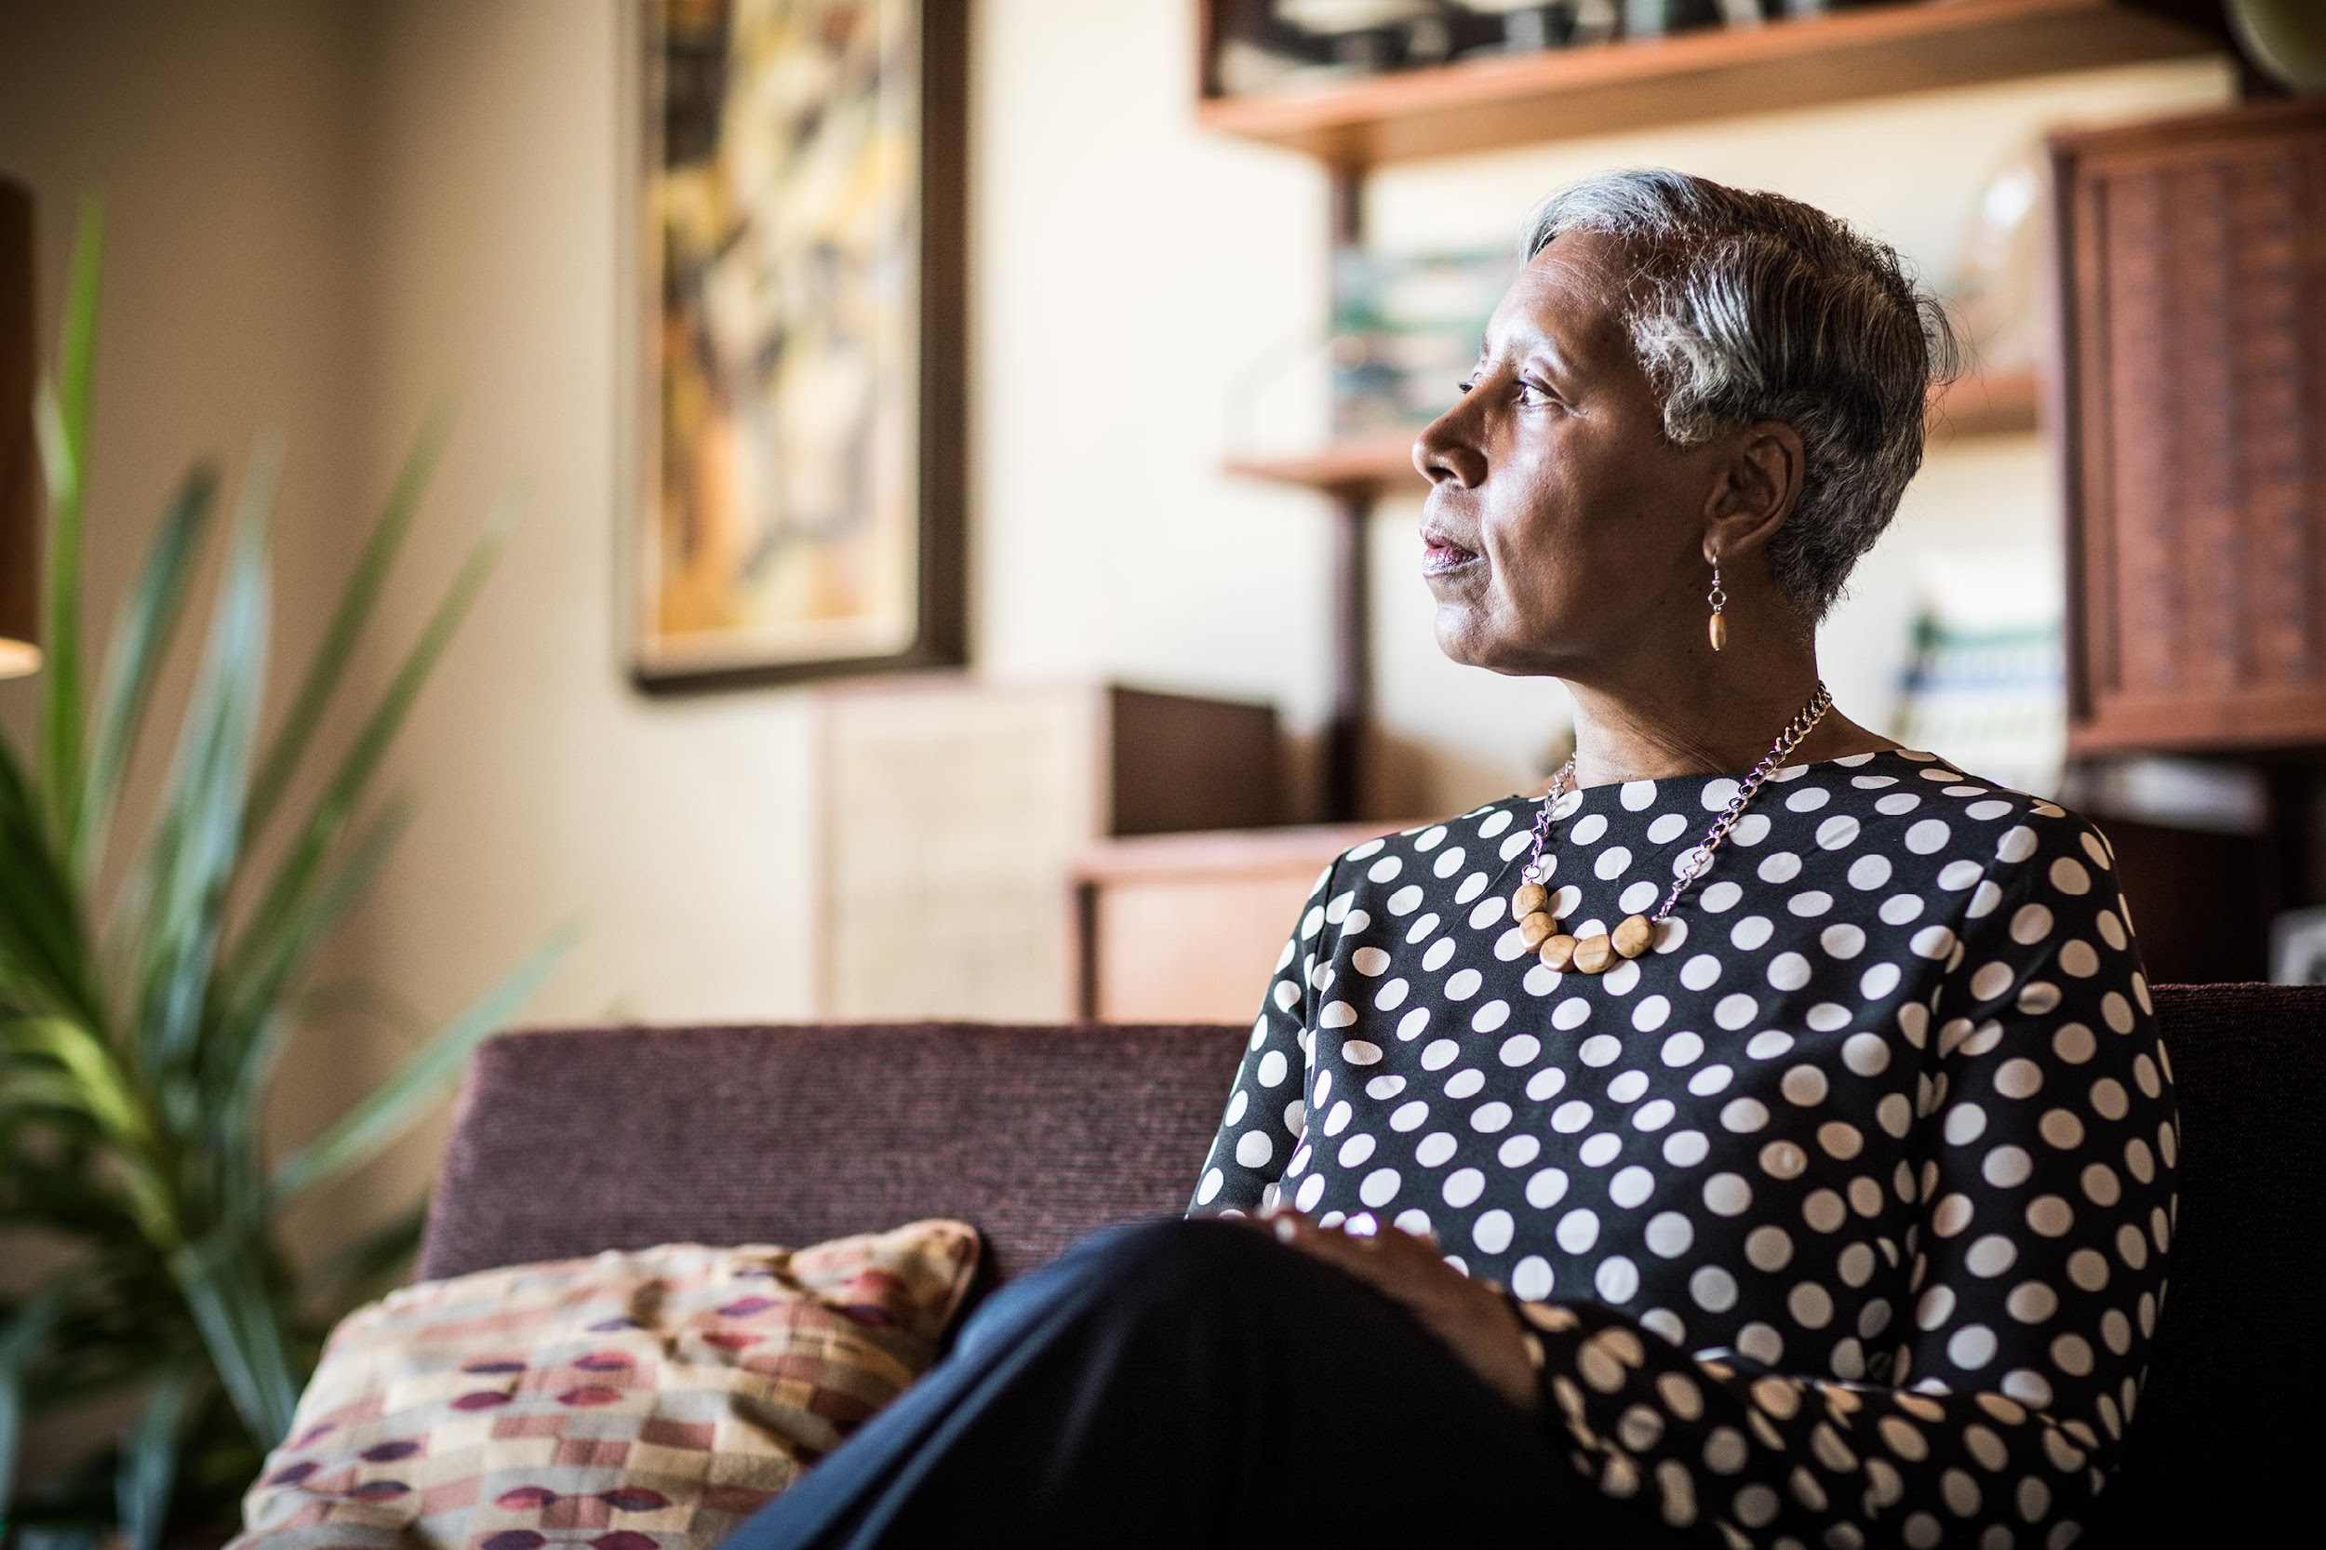
12-Elder Abuse
Refer to #3 Important Information
“Elder Abuse” is inflicting or threatening to inflict physical or sexual harm on a person over the age of 65, where the person committing the harm is in a position of trust or authority. This includes the failure to provide the necessities of life for the individual 65 years or over.
Timeline to report: 45 days from the incident
Required:
VQRP+ Application and Consent form to be reviewed and signed
Police incident and badge number
May be eligible for:
Community referrals and support
Safety planning

